Slide 1
FAST and IMAGE Coincident Viewing
11/17/16 Tagup

Slide 2
Ephem Status
FAST definitive Ephem provided by R. Strangeway
Time span: 1996 234 10:30:00.000 to 2009 121 02:26:49.990
SMA = 8300, ECC = 0.1898; INC = 82.97 (all the rest variable)
Inertial nodal regression rate = -0.5 deg/day; solar apparent motion 0.986 deg/day; movement in SM Local Time ~1.5 deg/day
IMAGE definitive Ephem constructed piece-wise from data obtained from CDAWeb (http://cdaweb.sci.gsfc.nasa.gov/cgi-bin/eval2.cgi)
Time span: 3/27/2000 00:00:55.000 to 12/19/2005 23:58:00.000
SMA = 29,815.4; ECC = 0.7531; INC = 90.010 (all the rest variable)

Slide 3

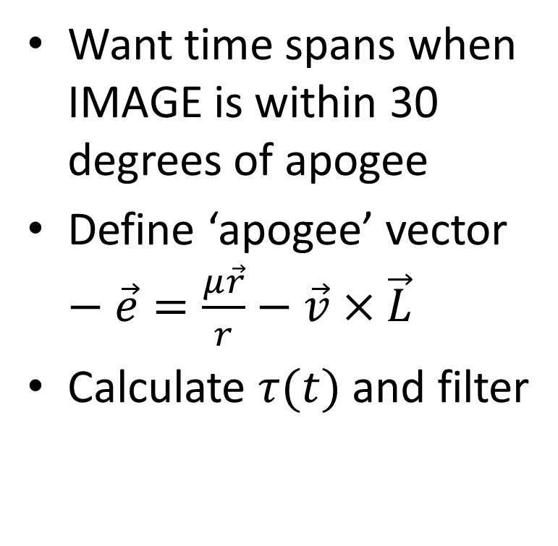




IMAGE Epoch Filtering Strategy
Want time spans when IMAGE is within 30 degrees of apogee
Define ‘apogee’ vector $−\vec{e}=\frac{μ\vec{r}}{r}−\vec{v}×\vec{L}$
Calculate $τ(t)$ and filter
$$−\vec{e}$$
$τ$ – angle between $−\hat{e}$ and $\vec{r}$
$$\vec{r}$$
$$τ$$
IMAGE Orbit

Slide 4

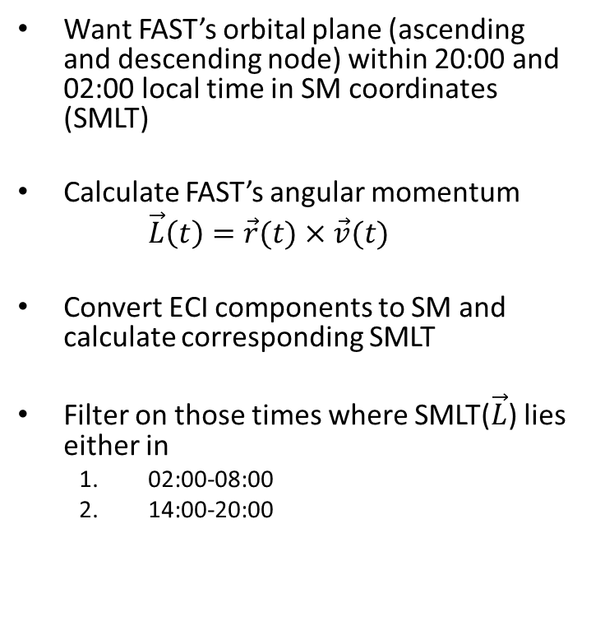



FAST Epoch Filtering Strategy
FAST Orbit
Want FAST’s orbital plane (ascending and descending node) within 20:00 and 02:00 local time in SM coordinates (SMLT)
Calculate FAST’s angular momentum
$\vec{L}\left(t\right)=\vec{r}(t)×\vec{v}(t)$
Convert ECI components to SM and calculate corresponding SMLT
Filter on those times where SMLT($\vec{L}$) lies either in
02:00-08:00
14:00-20:00
Sun
$$\vec{L}$$
$$\vec{L}$$
08:00
12:00
02:00
$${\hat{x}}_{SM}$$
(sunward)
14:00
20:00
$${\hat{y}}_{SM}$$

